Slide 1
Income Prediction
EDA

Slide 2
Independent Variables
age | relationship
workclass | Race
fnlwgt | Sex
education | capital.gain
education.num | capital.loss
marital.status | hours.per.week
occupation | native.country

Slide 3
Dependent Variable
Income
To predict whether the income is >50K or <=50K
Classification Problem

Slide 4
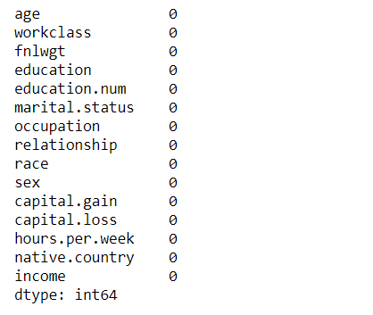
Checking for null values

Slide 5
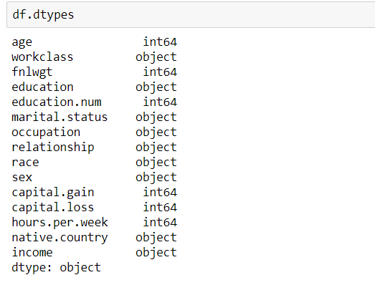
Checking for data types of variables

Slide 6
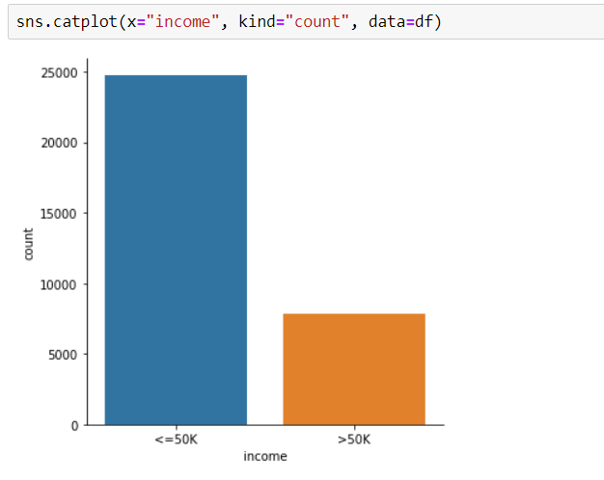
We can see that the data is highly imbalanced. The no of records for income <=50k is more than the records for income>50k.

Slide 7
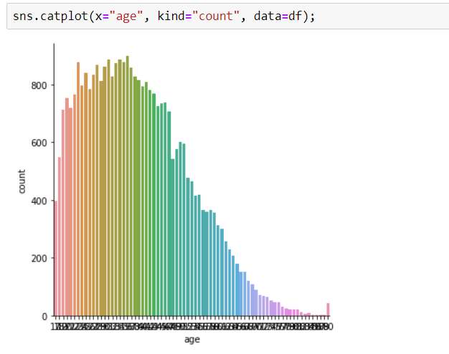
We see that the values for age are not normally distributed instead they are right skewed.

Slide 8
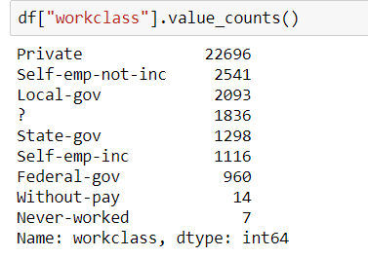
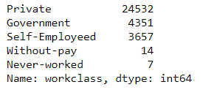
1) We see that workclass variable has various categories which can be combined to form five different categories. 2) Also the ? Values are replaced by the mode of workclass column.

Slide 9
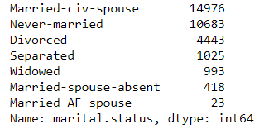

We see that marital.status variable has various categories which can be combined to form two different categories.

Slide 10
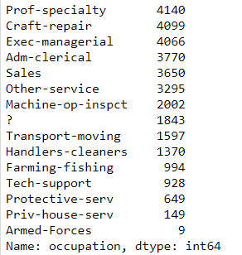
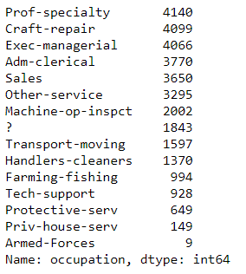
We see that the occupation variable has ? Values which are replaced by the mode of the column.

Slide 11
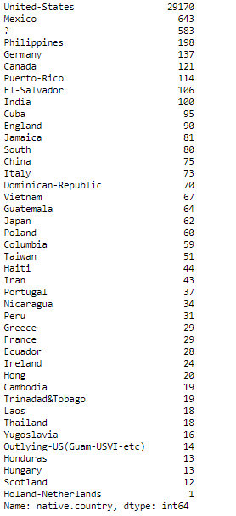
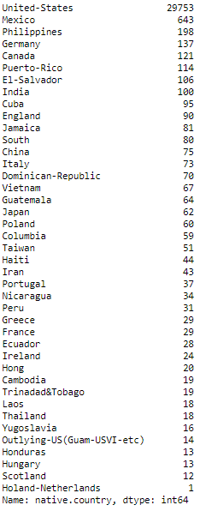
1) The ? Values in the native.country variable can be replaced by the mode of the column. 2) As the no.of categories are very large in this column we can ignore this column

Slide 12
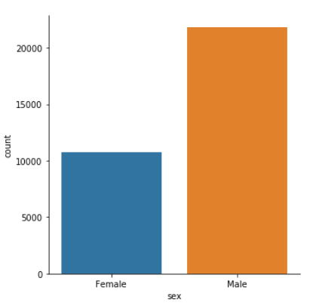
We can see that the entries for male sex is more than that for female sex.

